Slide 1
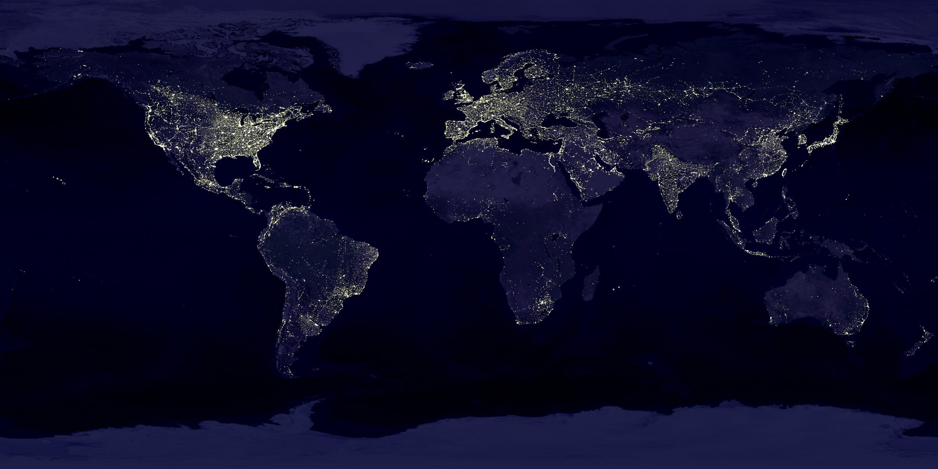
Global Life Expectancy Analysis
Group 5
Arda Cankat Bati
Qingyuan Jin
Weinan Li
Wei Zhang

Slide 2

OUTLINE
Introduction
Dataset Overview
Motivation
Differences between countries
Relevance Analysis
Change through years
Conclusion
Conclusion

Slide 3

Introduction

Slide 4

Introduction
Life Expectancy: The average period that a person may expect to live.
Problem: affected by too many variables
Harder to analyse for individuals, more
predictable for groups
Selecting variables that apply in general is
the key

Slide 5

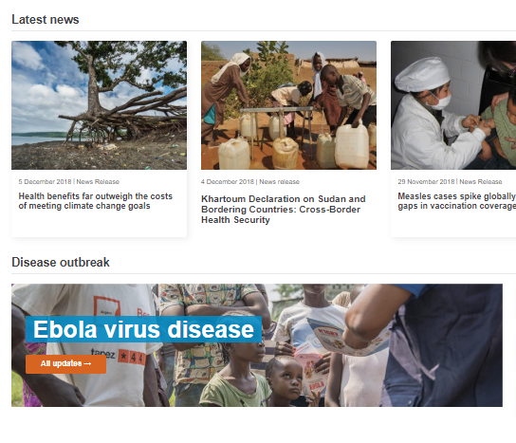
Dataset
Dataset taken from kaggle.com
Generated from the World Health Organization website
193 countries, 21 Features, between 2000 – 2015
Features: Economical, Physical, Diseases etc.
Some incomplete points, required more cleaning than normal

Slide 6

Motivation

Slide 7
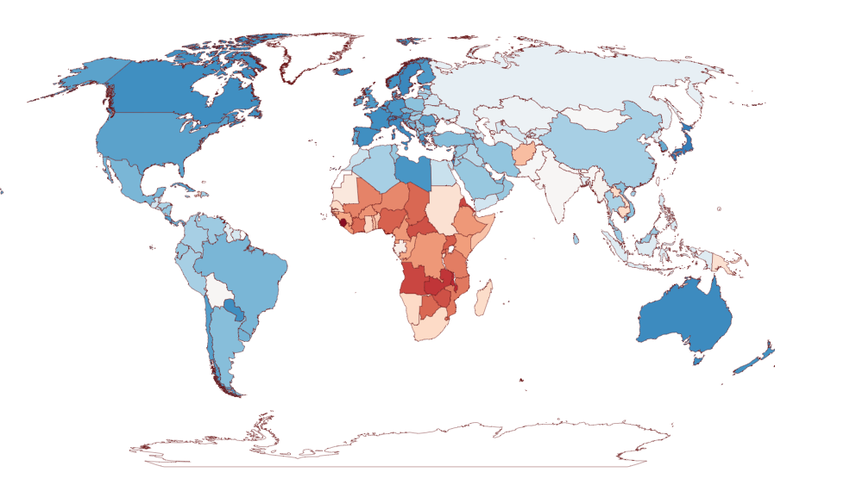
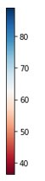
Life Expectancy in the year 2000
in years

Slide 8
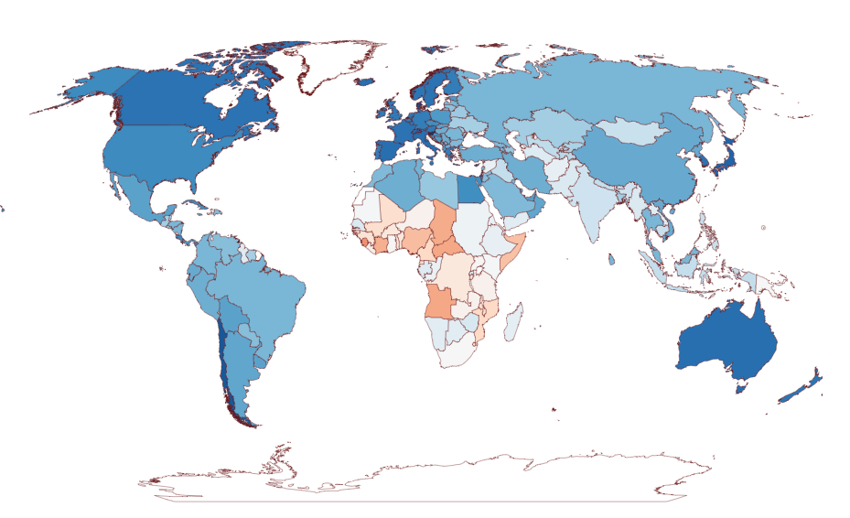
Life Expectancy in the year 2015
in years

Slide 9
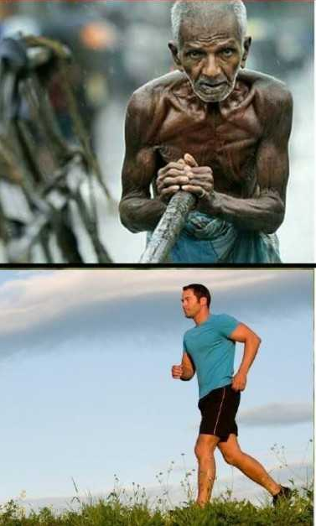
Motivation
Big difference between the countries
What features play a major role in this difference?
Overall increasing life expectancy from 2000 to 2015
How can we keep it up?
How can the lower life exp. countries do better?

Slide 10

Difference

Slide 11
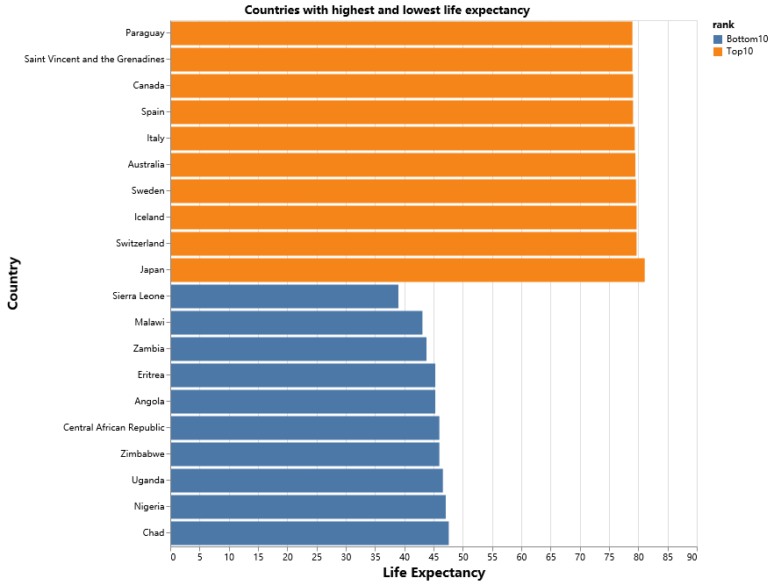
The huge gap in our world
The Top and Bottom 10
People in the Top 10 countries averagely live 40 years longer than the bottom 10.
In 2000, Japan had a life expectancy twice larger than that of Sierra Leone

Slide 12
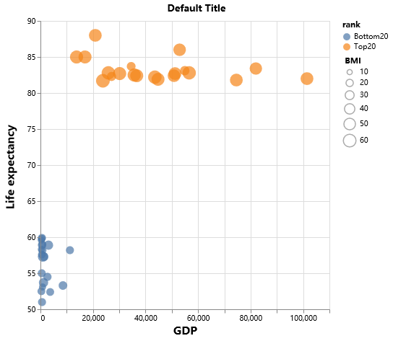
Why?
Higher BMI cause health problem?
In poor countries, people don’t even have enough food.

Slide 13
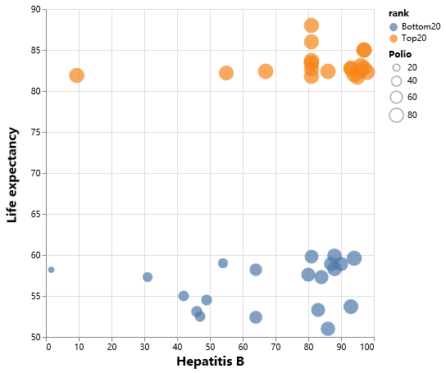
Why?
Despite having similar coverage of some vaccines, poor countries are still suffering.

Slide 14
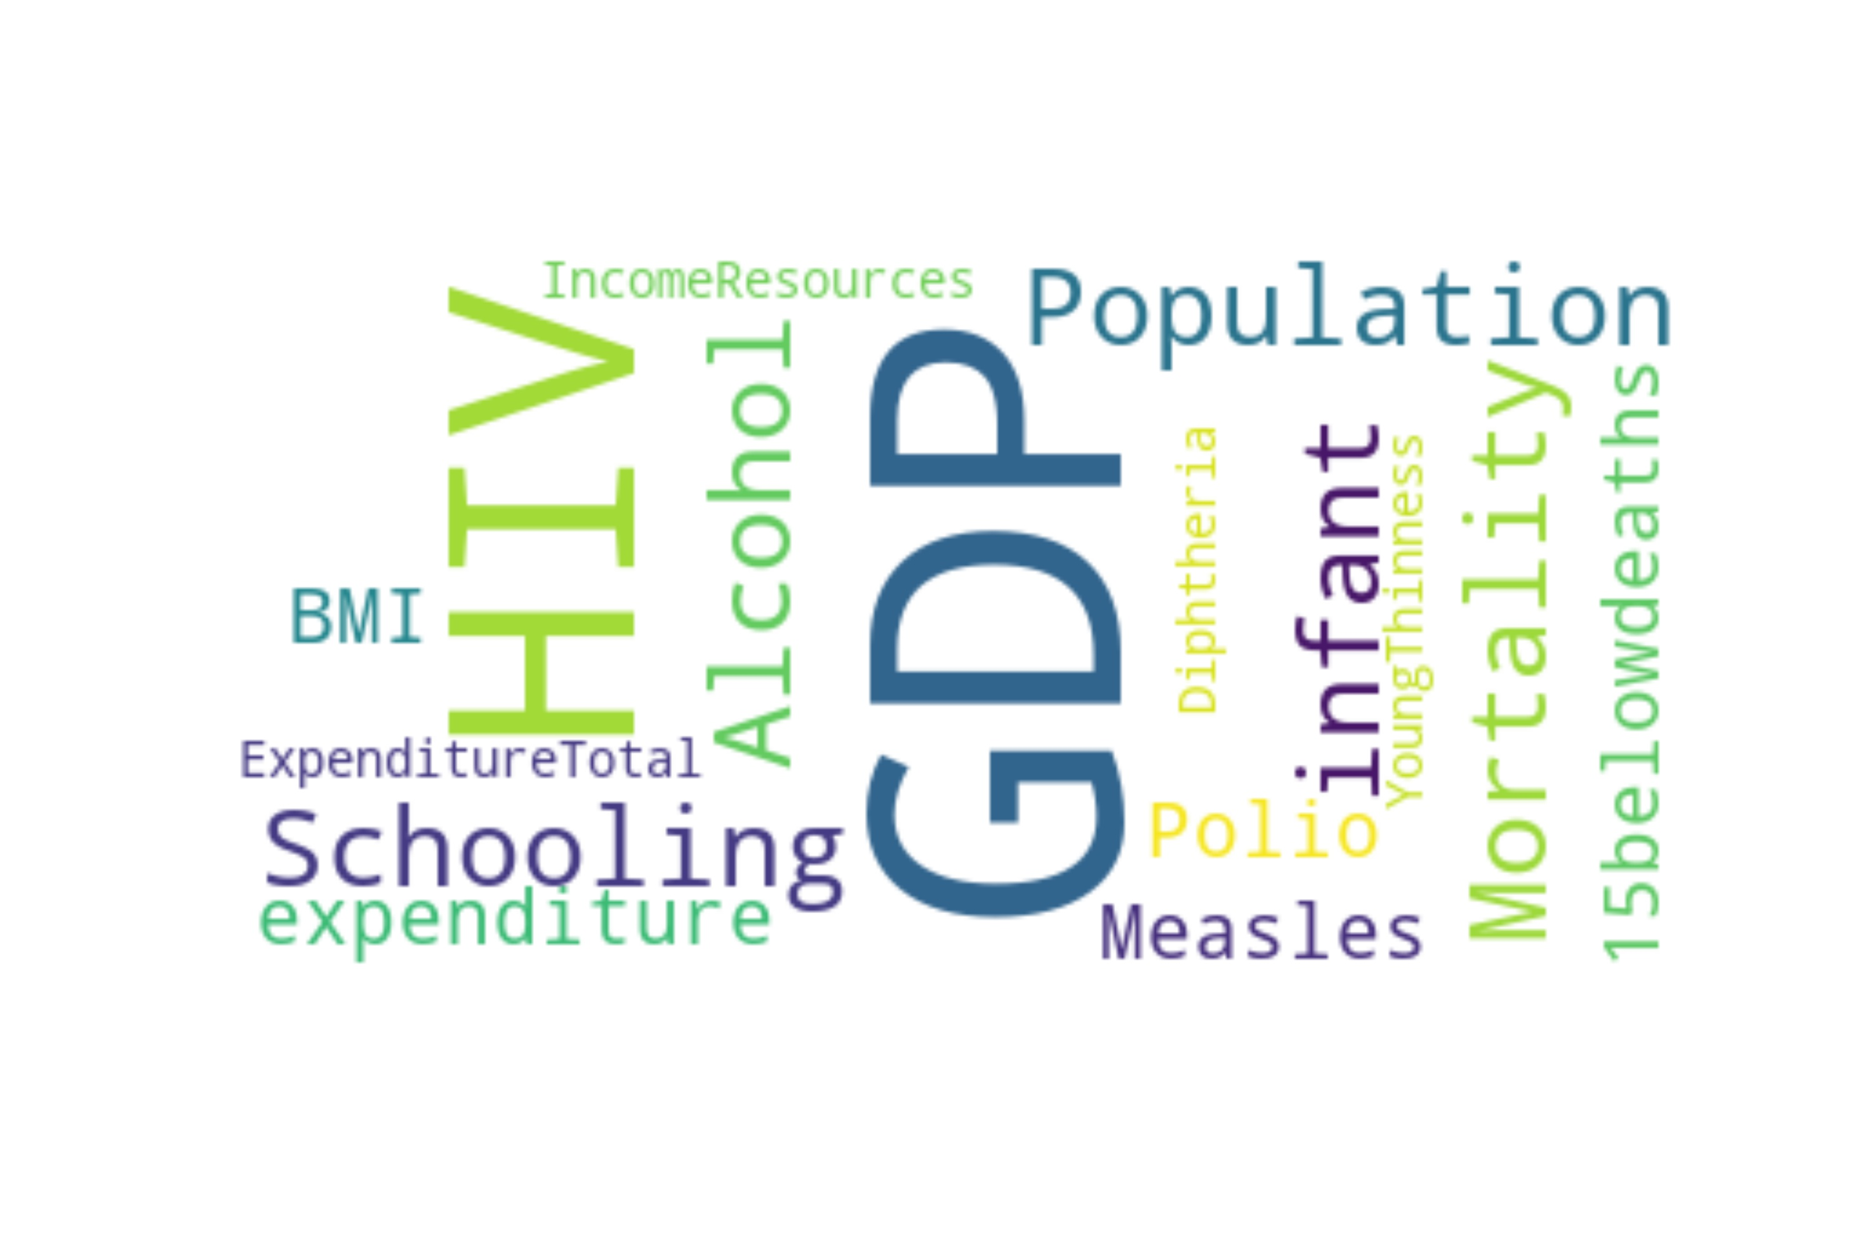
Relevance
Analysis

Slide 15


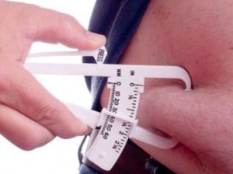
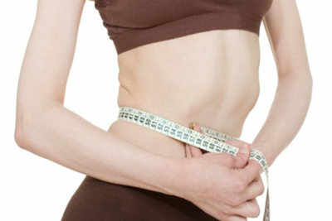
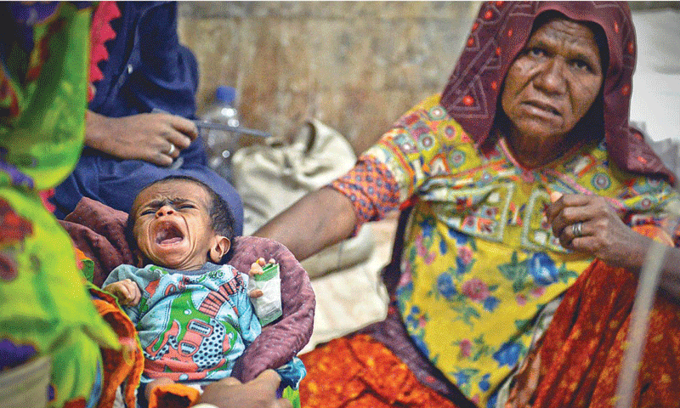

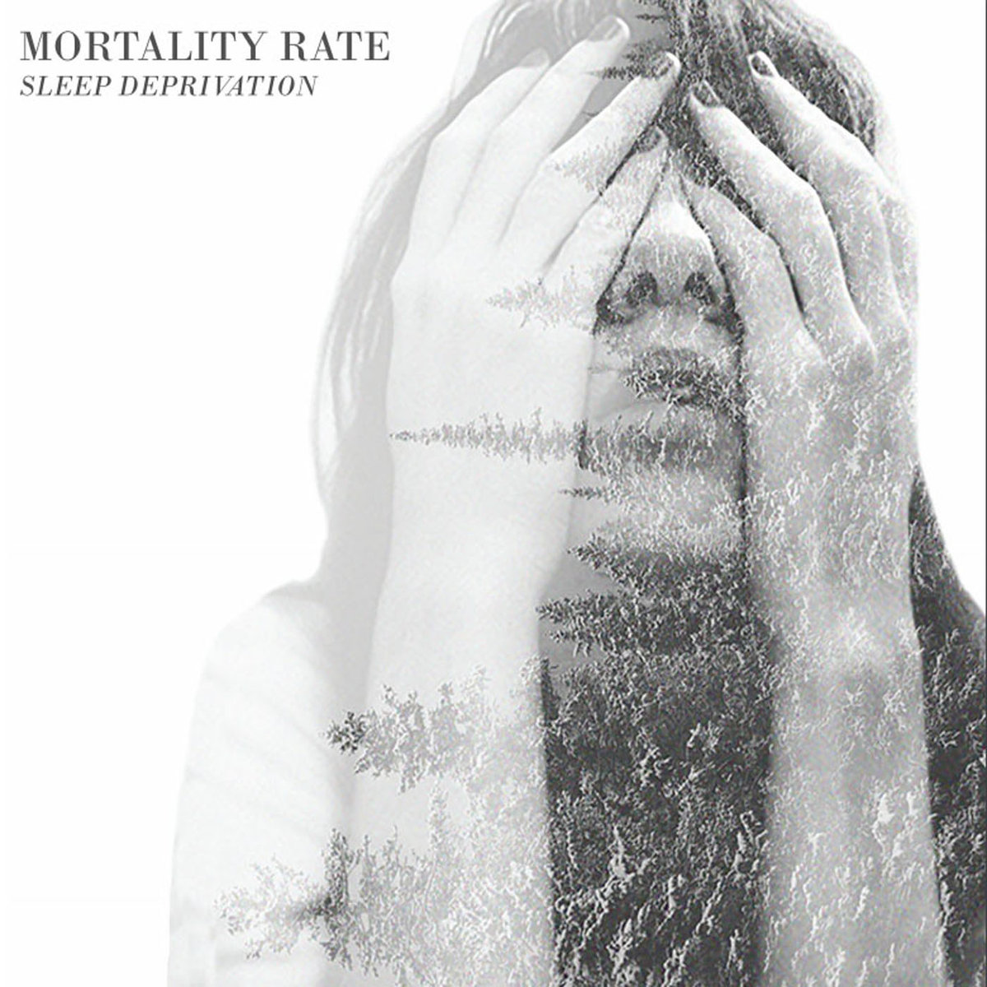



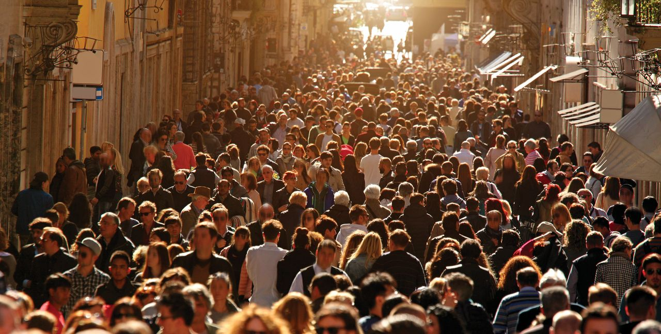


19 Features
 

Slide 16
PCA
6 most relevant Feature
GDP
HIV
Hepatitis B
Adult Mortality
Income resources
Schooling
Goal
Select most relevant features
Narrow down our target

Slide 17
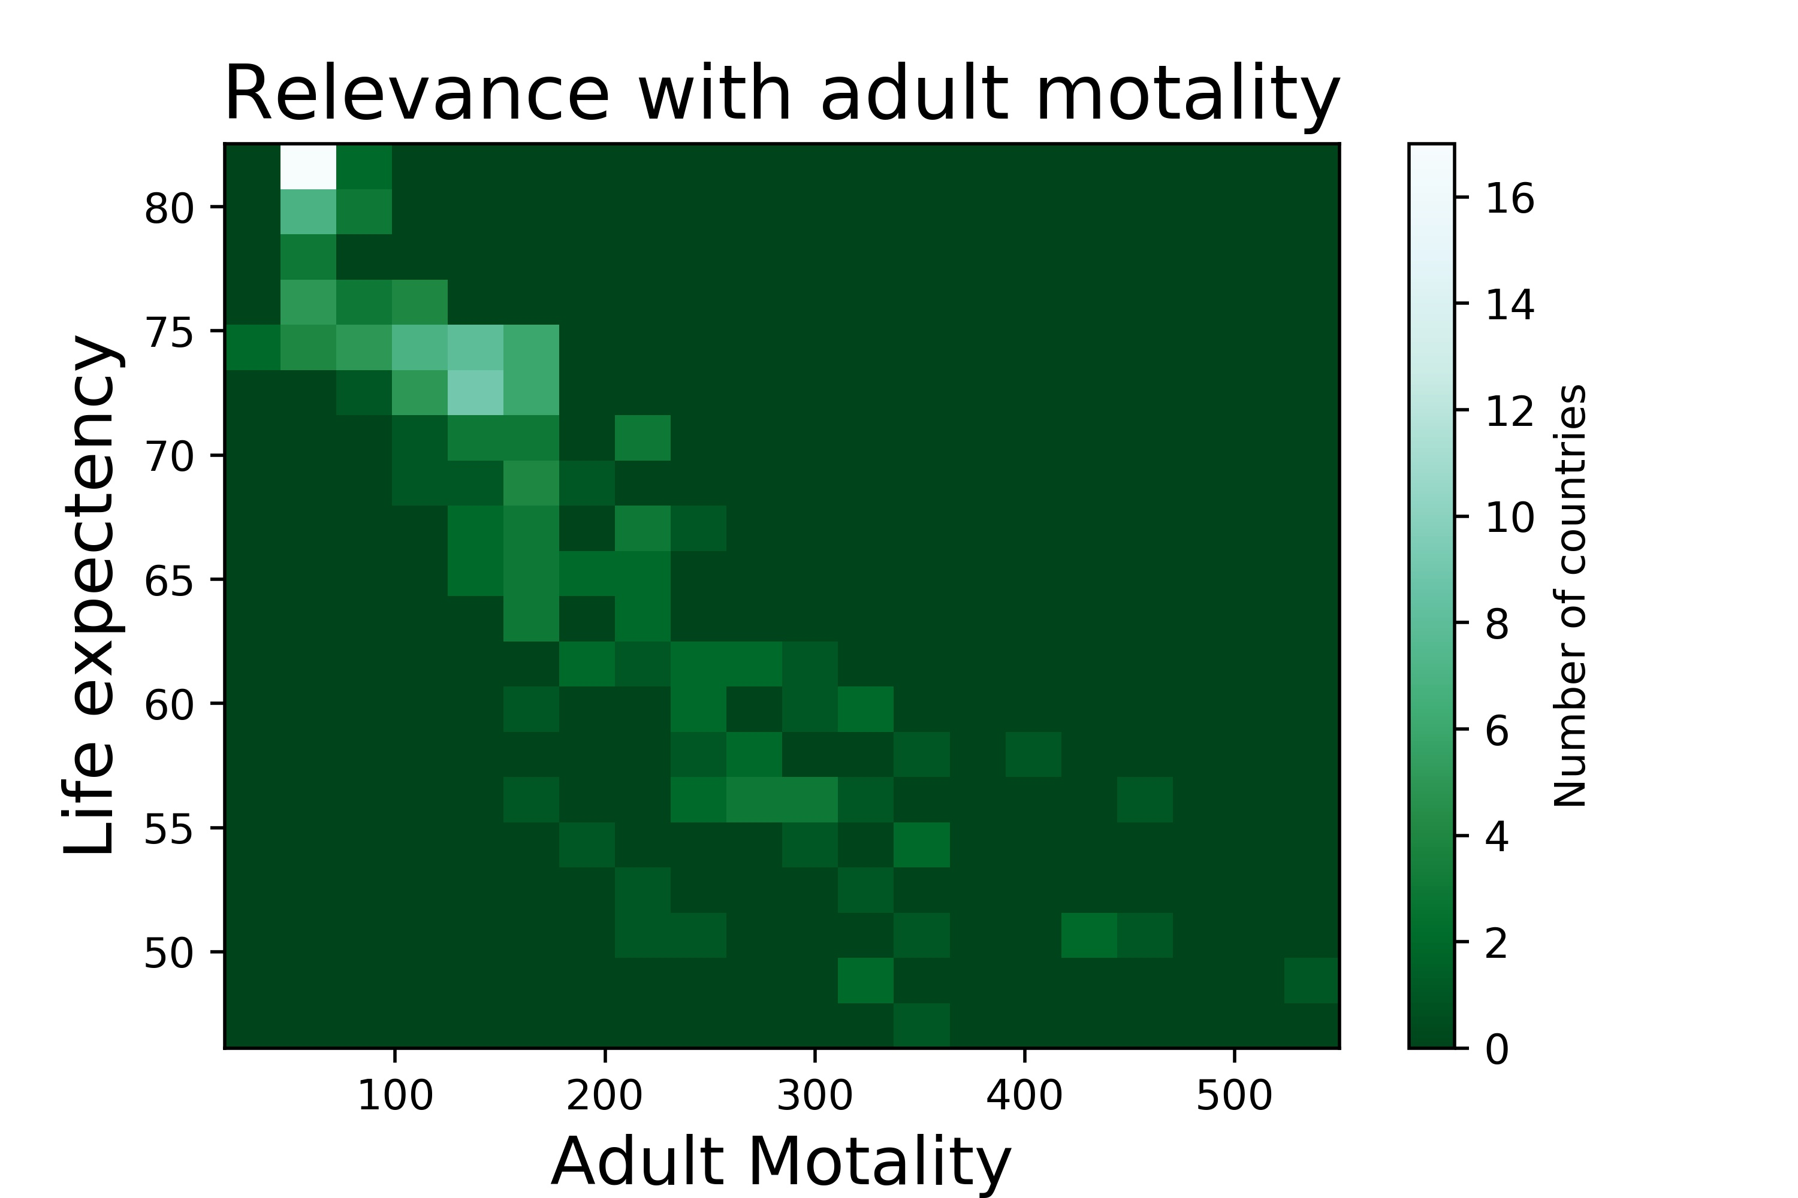
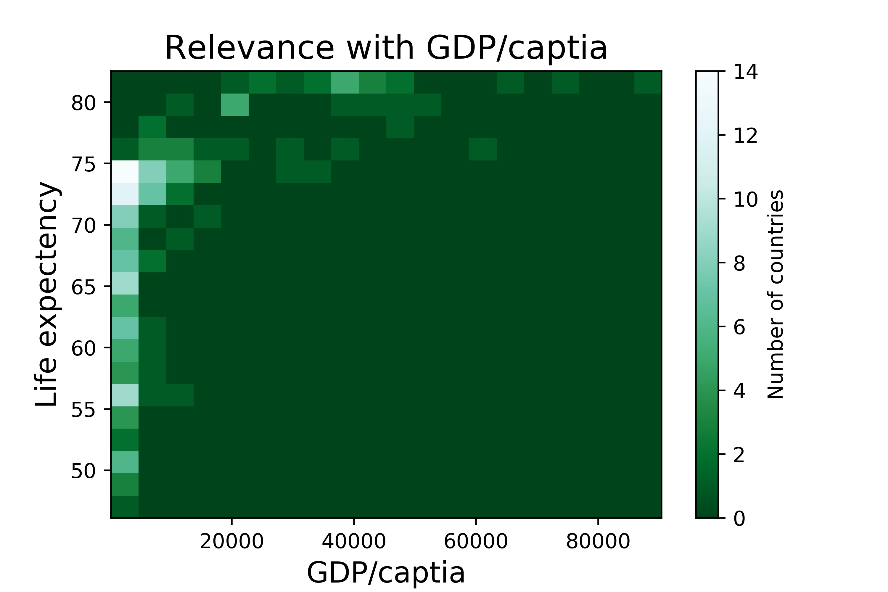

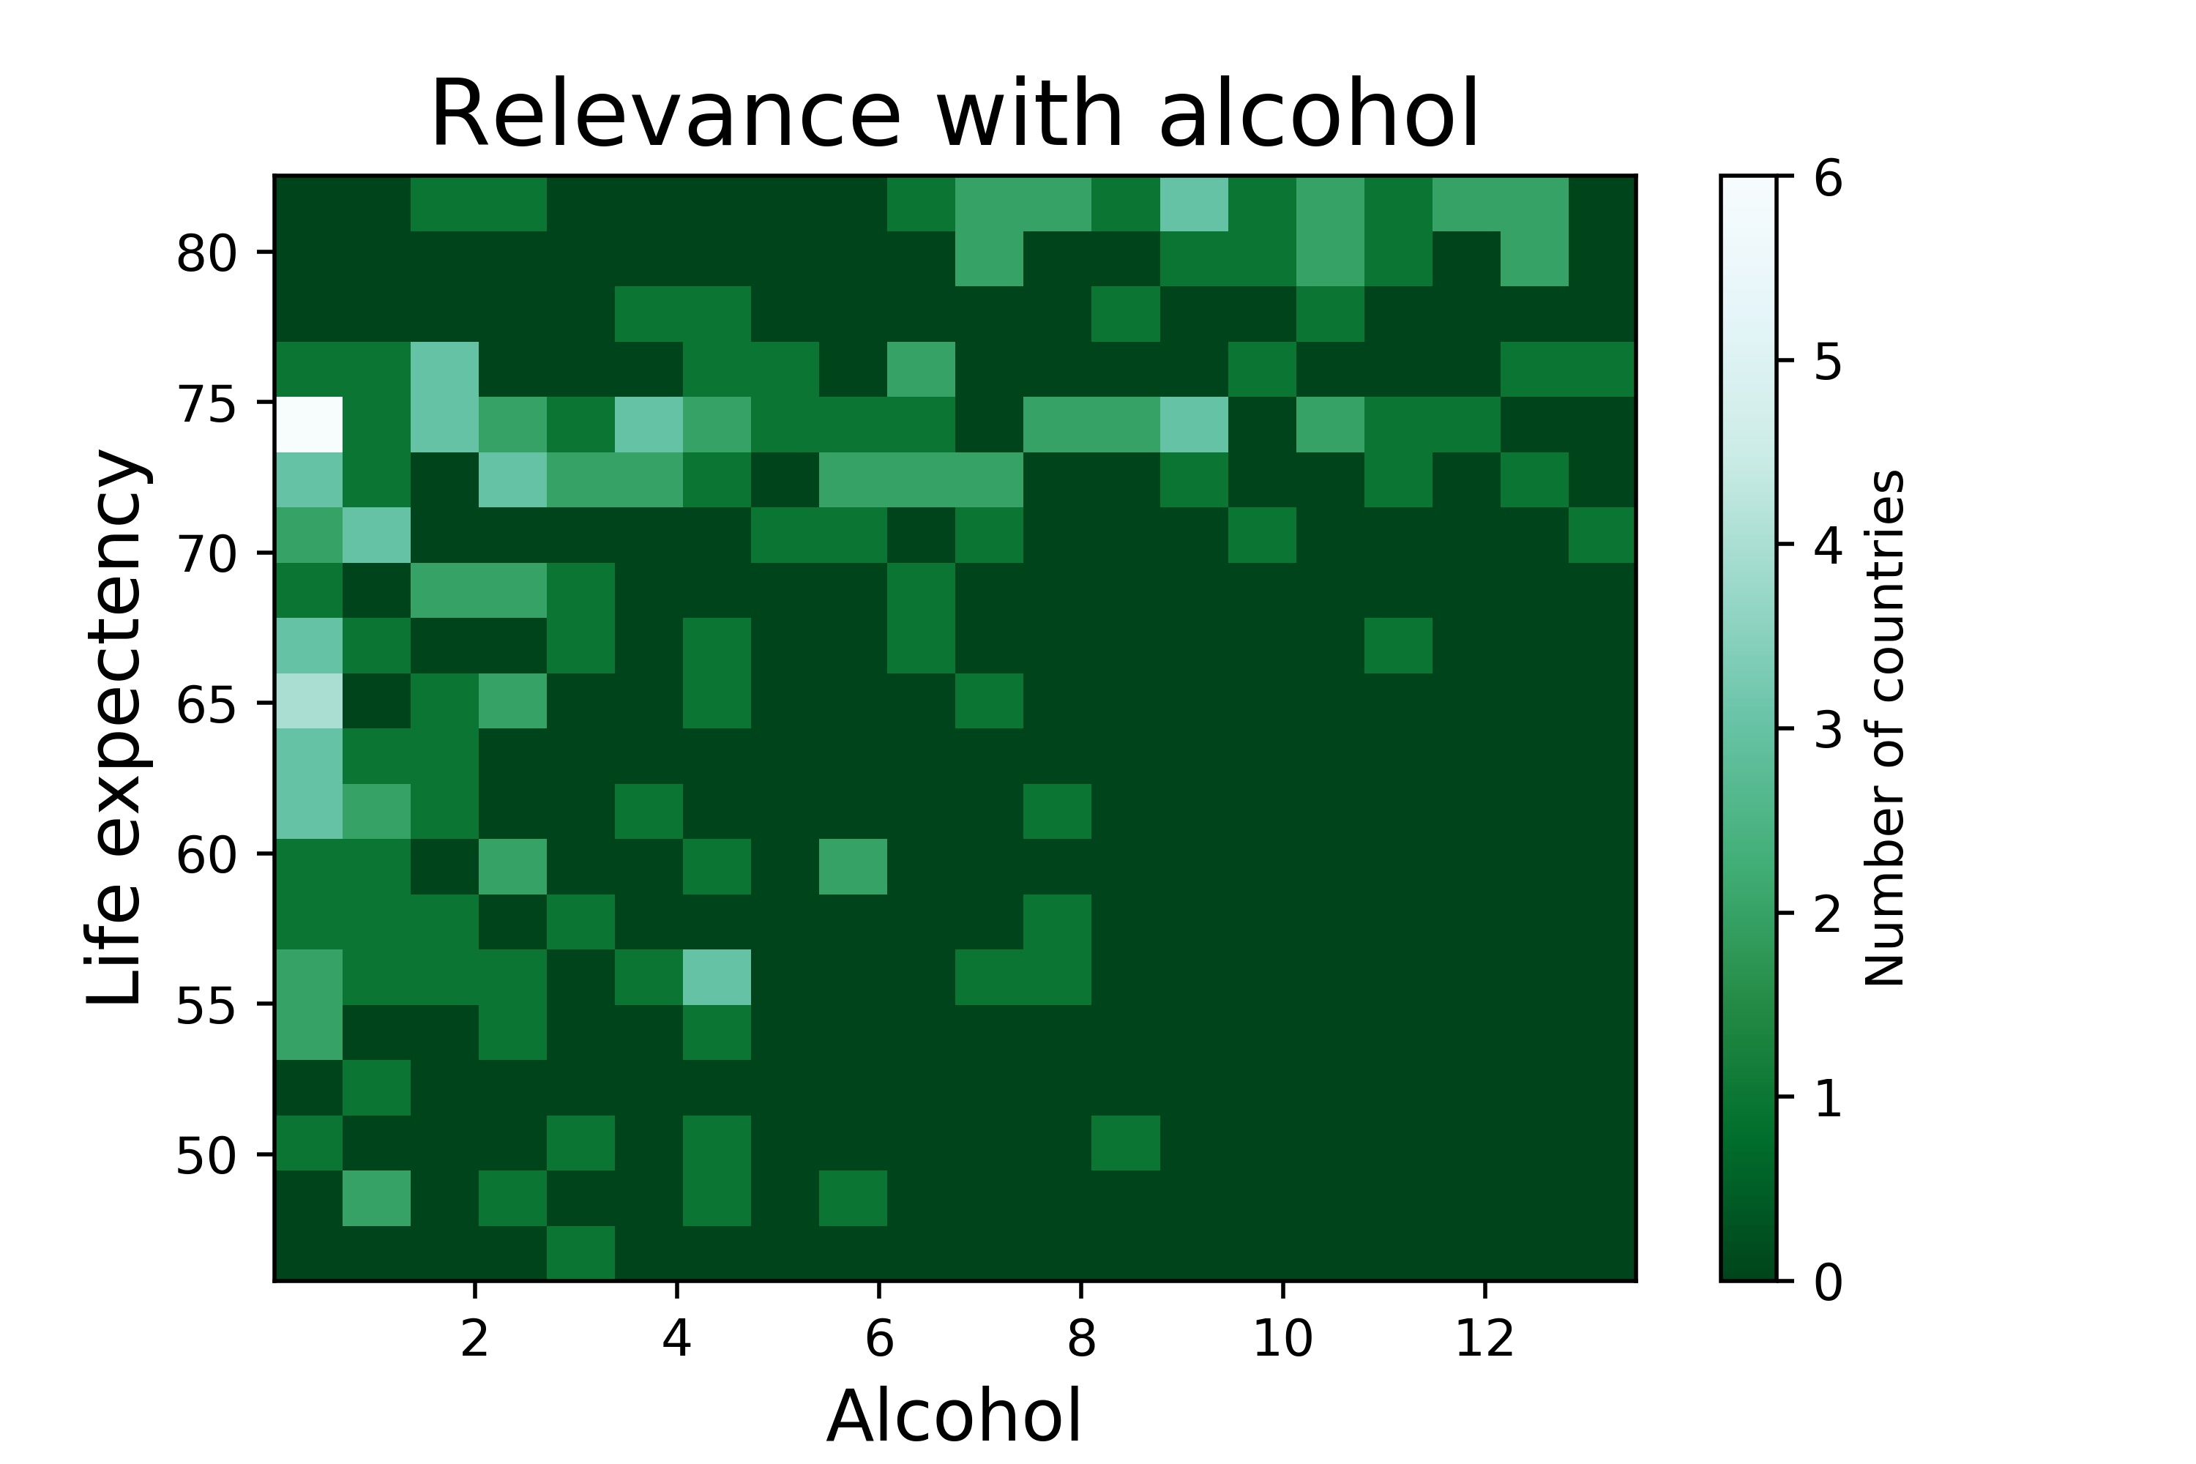
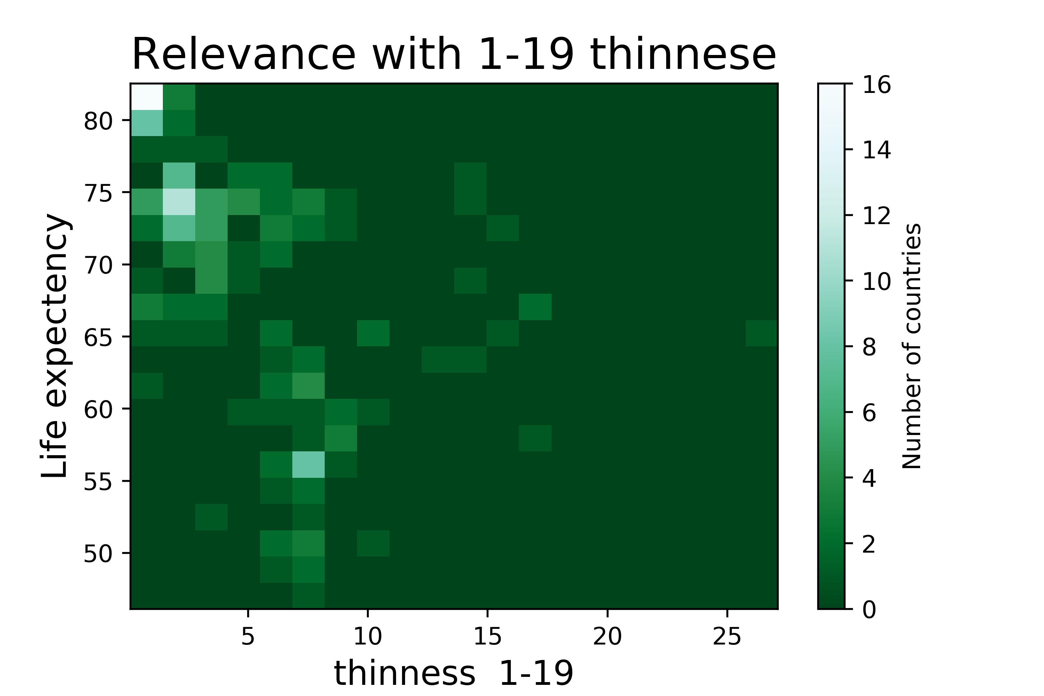

PCA

Slide 18
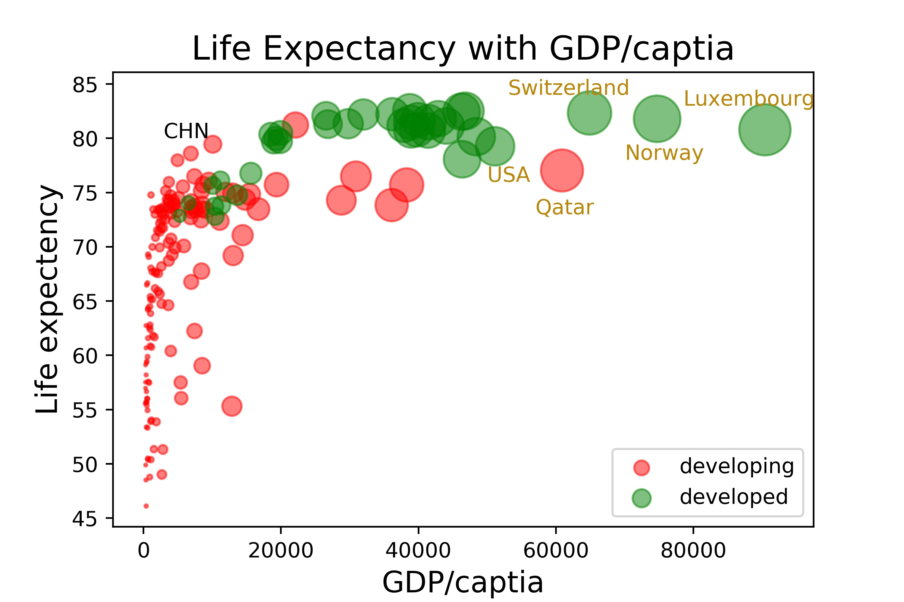

Life Expectancy vs GDP
Larger spots, higher GDP/captia
Life expectancy is positive relevant with GDP/cap
Developed countries is richer than developing ones, so they have longer life
Northern Europe countries
Developing countries

Slide 19
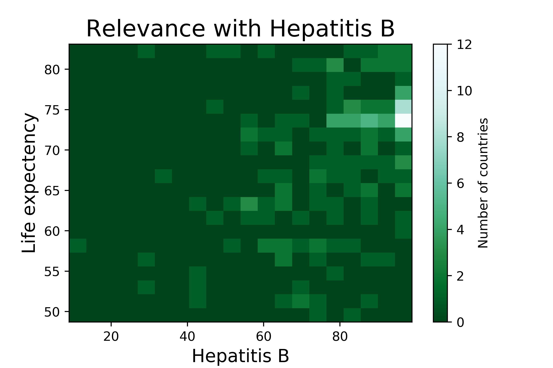
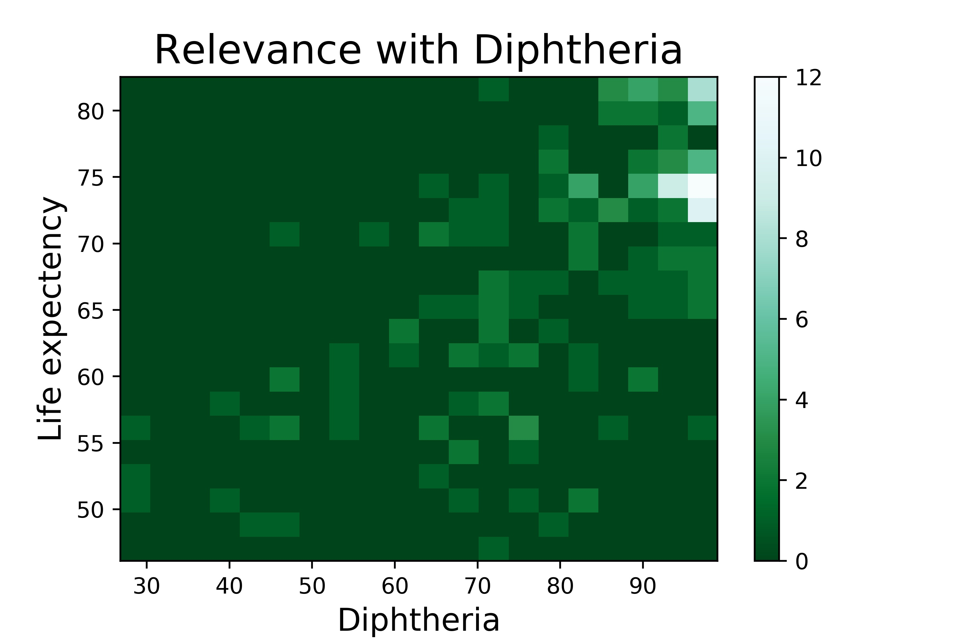
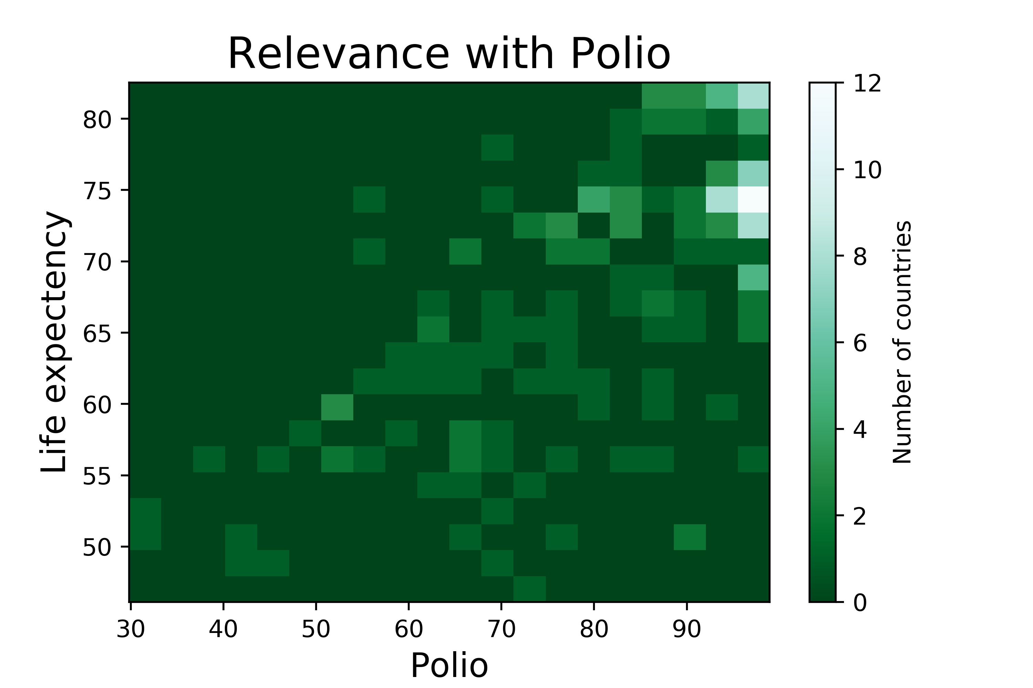
Roughly higher vaccine injection rate, higher life expectancy
They have almost the same relevance
Go with CDP
Vaccine

Slide 20

Change
through the
years

Slide 21
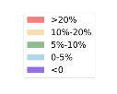

Slide 22
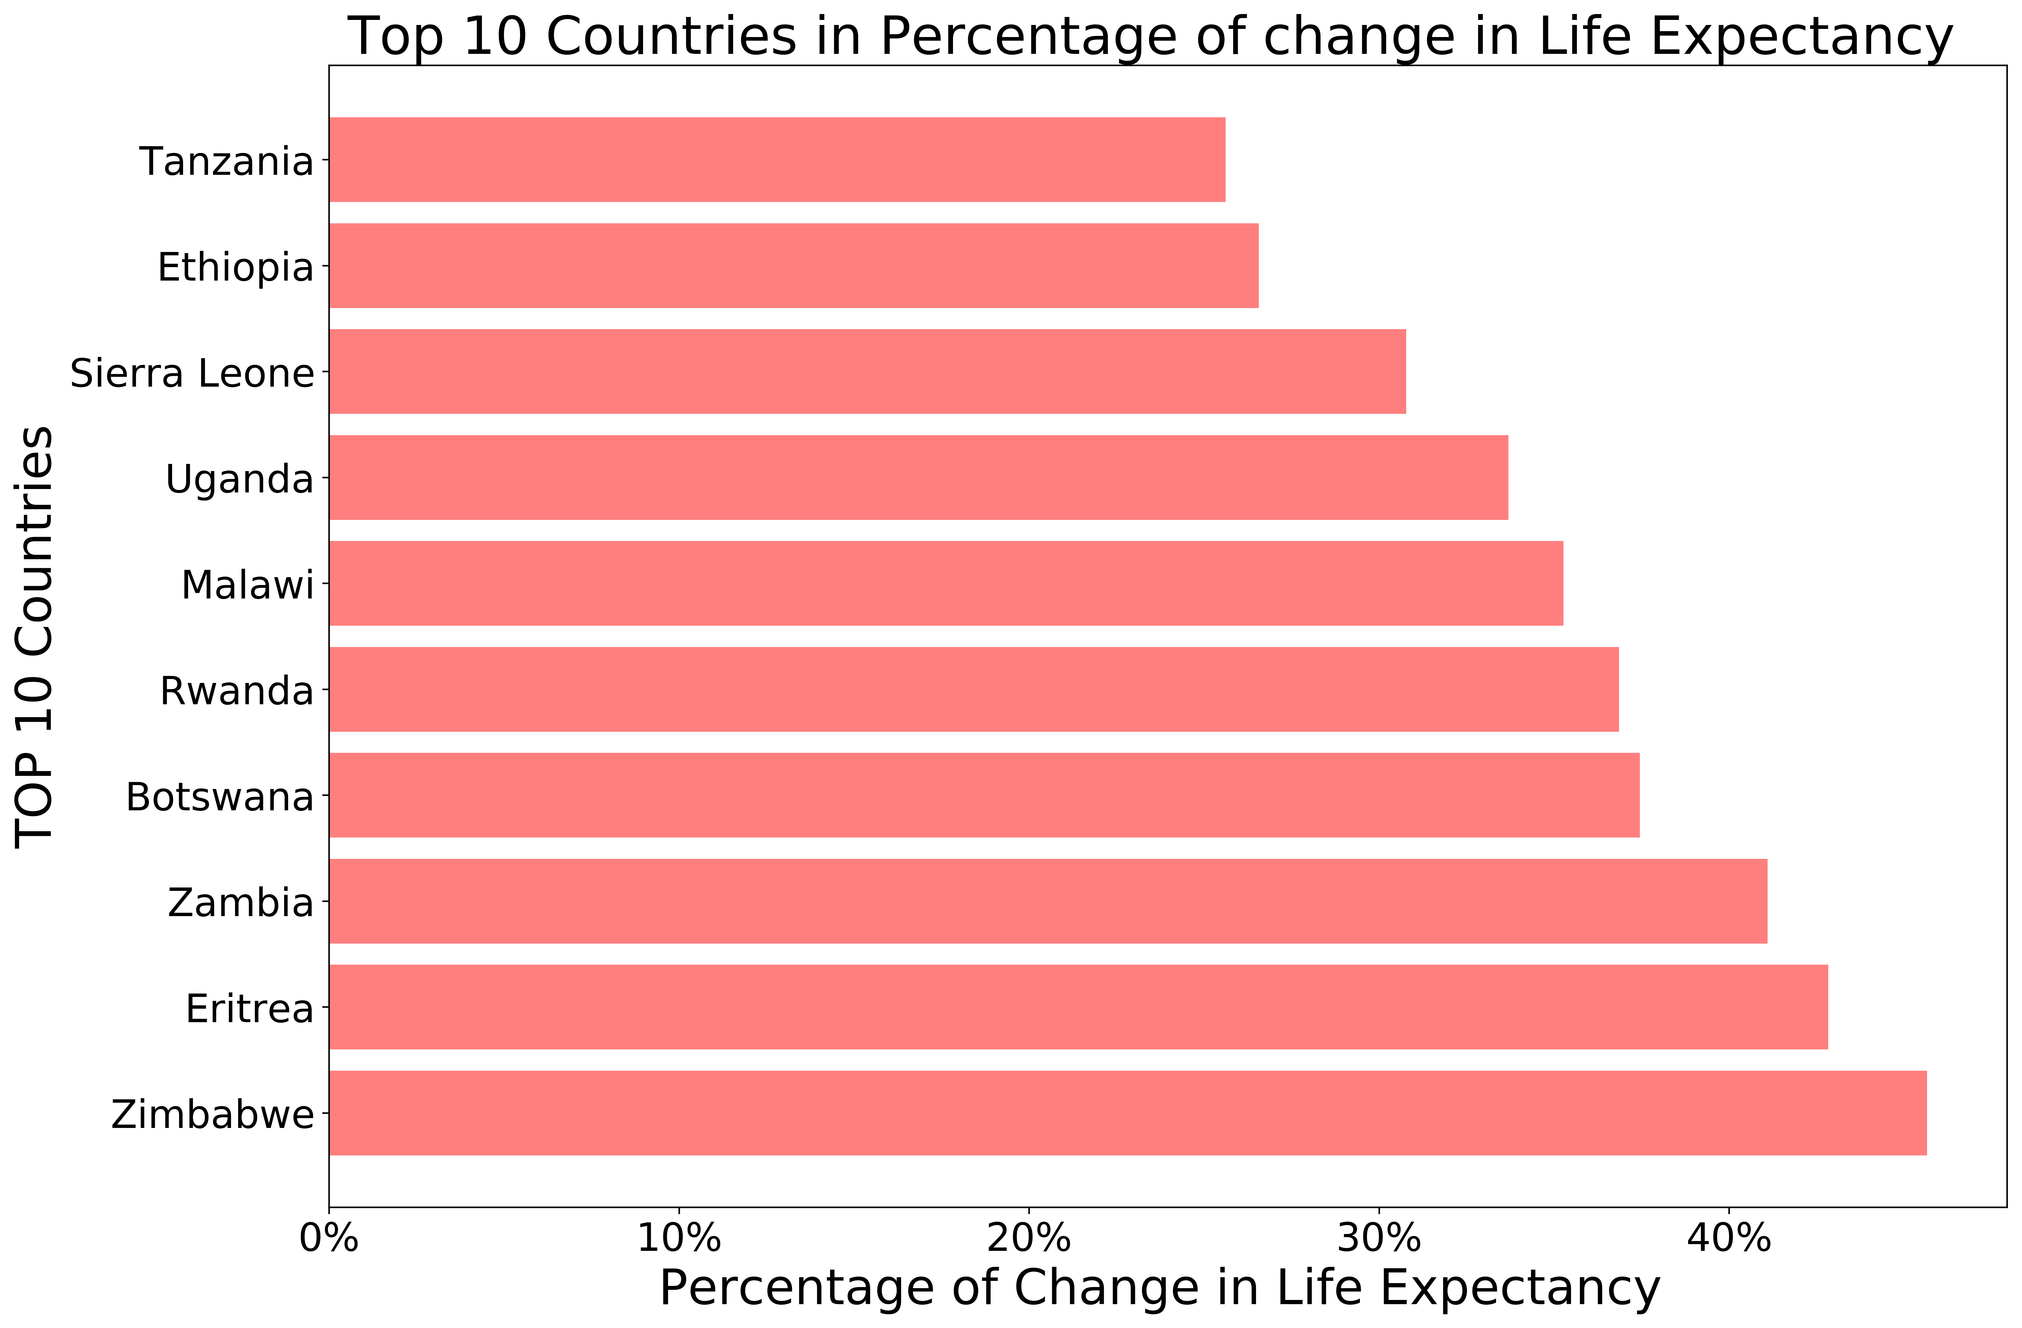

Slide 26
Conclusion

Slide 27
Conclusion
1. Features that affected life exp. The most in general were GPD, Adult Mortality and HIV / Hepitatis B
2. For countries that want to rapidly increase their life expectancy, HIV, income and adult mortality are the most significant features
3. More research can be done into underlining relations between the features, especially for GDP per capita.

Slide 28
THANK YOU

